Slide 1
Quantifying Promotion Effectiveness
Vision
Formulate an approach that is practical to implement on an ongoing basis for the evaluation of millions of promotions offered in stores each year.

Slide 2
Key terms
Baseline : Baseline sales measure what a product’s sales would have been had it not been promoted.
Adjusted_Baseline : Adjust the calculated baseline by incorporating impacts of substitute and complementary products.
Halo : Lift in sales of items that go well with the anchor item (complementary items).
Cannibalization : Loss in sales of competing/substitute items due to anchor item’s promotion.
Uplift : Difference in actual quantity sold during promotion and baseline.

Slide 3
Why adjust baseline?
In baseline calculation product’s sales information considered in isolation
Assumption: substitute/complementary items impact as none
Item1:Anchor item (on promotion) substitute items of anchor_item: a, b item to which anchor item is complementary: x
Complementary item of item1 :y
a and x are on promotion
adjusted_baseline = baseline – cannibalization + halo
adjusted_baseline = baseline
– baseline * similarity_index(item1,a) * (cross_price_elastisity of item1,a)
+ baseline * affinity_index(item1,x) * ( cross_price_elastisity of item 1,x)
Currently Used Formule:
adjusted_baseline = baseline
– uplift_a * similarity_index(item1,a) * (sales ratio of item1,a)
+ uplift_x * affinity_index(item1,x) * ( sales ratio of item 1,x)

Slide 4
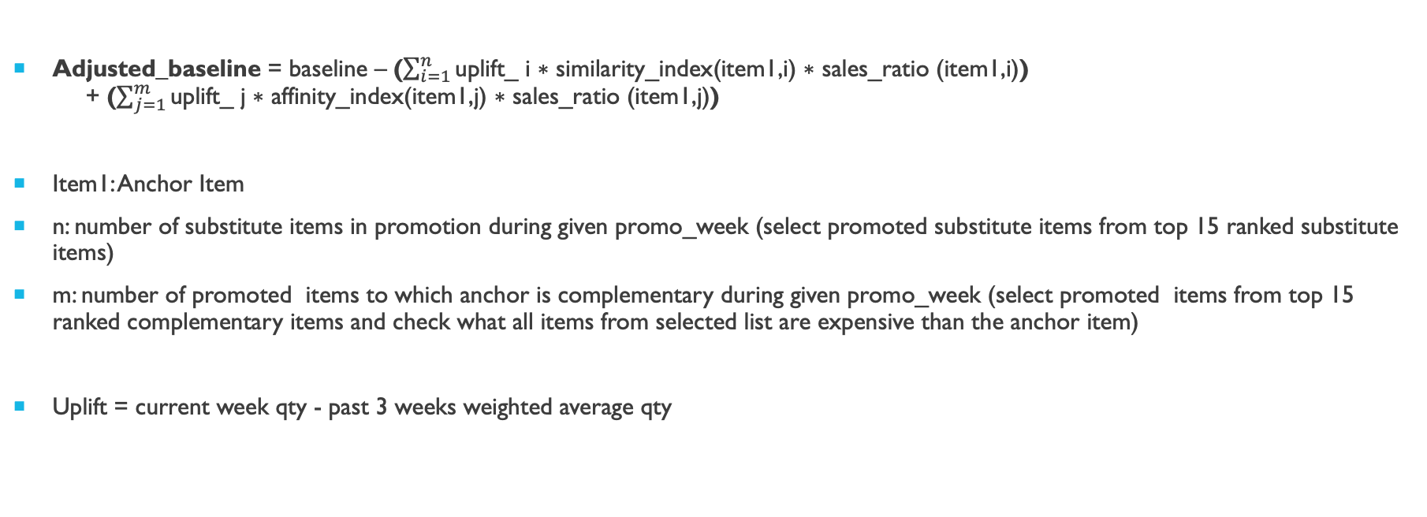
Adjusted Baseline Formula
Adjusted_baseline = baseline – ($\sum_{i=1}^{n}{\text{uplift}\text{_} \text{i} \text{∗ }\text{similarity}\text{_}\text{index}\text{(}\text{item}\text{1,}\text{i}\text{) ∗ }\text{sales}\text{_}\text{ratio}\text{ (}\text{item}\text{1,}\text{i}\text{)}\text{)} }$ + ($\sum_{j=1}^{m}{\text{uplift}\text{_} \text{j} \text{∗ }\text{affinity}\text{_}\text{index}\text{(}\text{item}\text{1,}\text{j}\text{) ∗ }\text{sales}\text{_}\text{ratio}\text{ (}\text{item}\text{1,}\text{j}\text{)}}$)
Item1: Anchor Item
n: number of substitute items in promotion during given promo_week (select promoted substitute items from top 15 ranked substitute items)
m: number of promoted items to which anchor is complementary during given promo_week (select promoted items from top 15 ranked complementary items and check what all items from selected list are expensive than the anchor item)
Uplift = current week qty - past 3 weeks weighted average qty

Slide 5
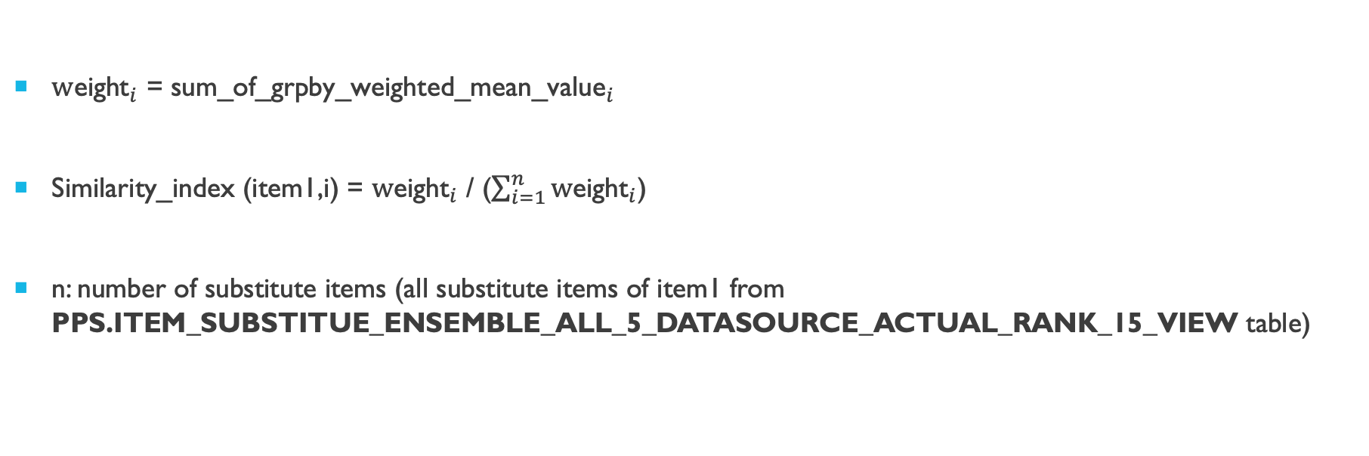
Similarity_index
${\text{w}\text{eight}}_{i}$ = ${\text{sum}\text{_}\text{of}\text{_}\text{grpby}\text{_}\text{weighted}\text{_}\text{mean}\text{_}\text{value}}_{i}$
Similarity_index $\text{(}\text{item}\text{1,}\text{i}\text{) }$= ${\text{w}\text{eight}}_{i}$ / ($\sum_{i=1}^{n}{{\text{w}\text{eight}}_{i}}$)
n: number of substitute items (all substitute items of item1 from PPS.ITEM_SUBSTITUE_ENSEMBLE_ALL_5_DATASOURCE_ACTUAL_RANK_15_VIEW table)

Slide 6
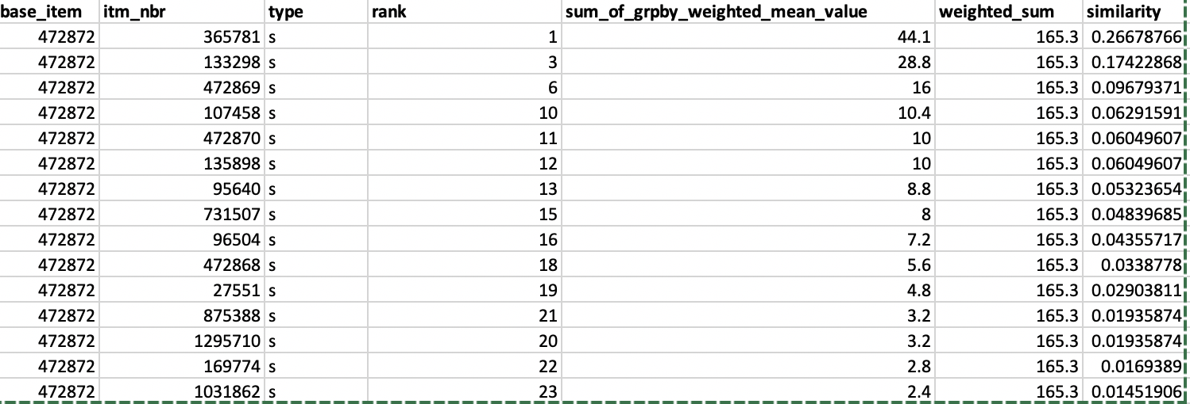
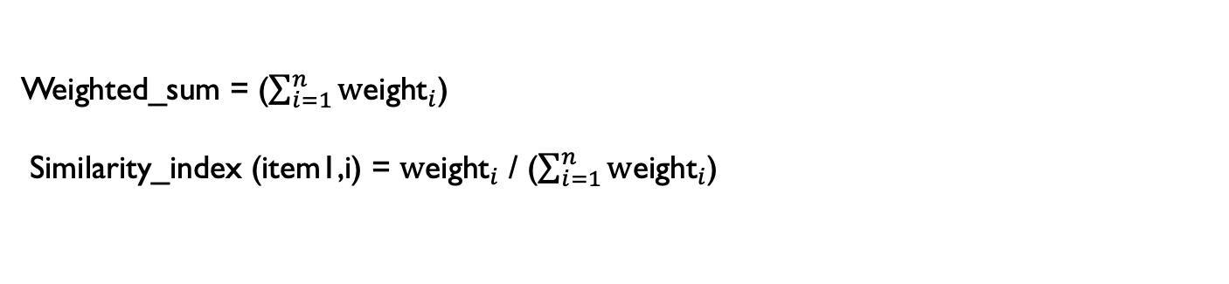
Weighted_sum = ($\sum_{i=1}^{n}{{\text{w}\text{eight}}_{i}}$)
Similarity_index $\text{(}\text{item}\text{1,}\text{i}\text{) }$= ${\text{w}\text{eight}}_{i}$ / ($\sum_{i=1}^{n}{{\text{w}\text{eight}}_{i}}$)

Slide 7
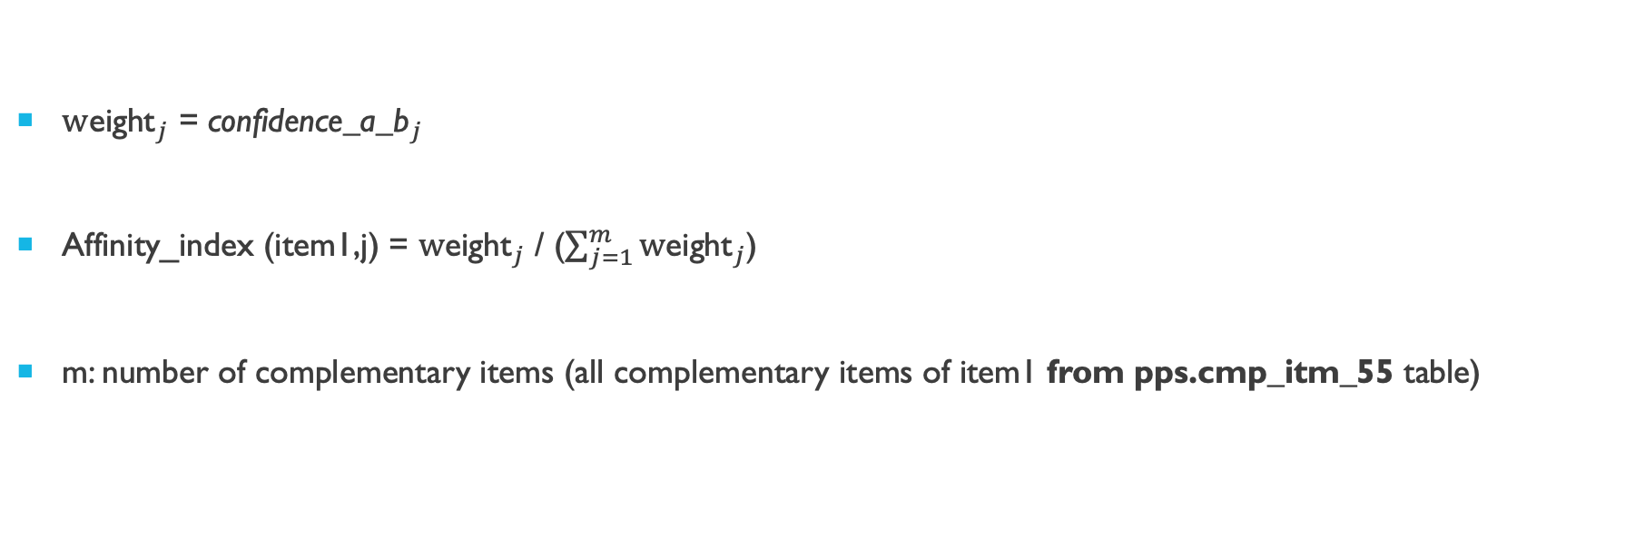
Affinity_index
${\text{w}\text{eight}}_{j}$ = ${\text{confidence}\text{_}\text{a}\text{_}\text{b}}_{j}$
Affinity_index $\text{(}\text{item}\text{1,}\text{j}\text{) }$= ${\text{w}\text{eight}}_{j}$ / ($\sum_{j=1}^{m}{{\text{w}\text{eight}}_{j}}$)
m: number of complementary items (all complementary items of item1 from pps.cmp_itm_55 table)

Slide 8
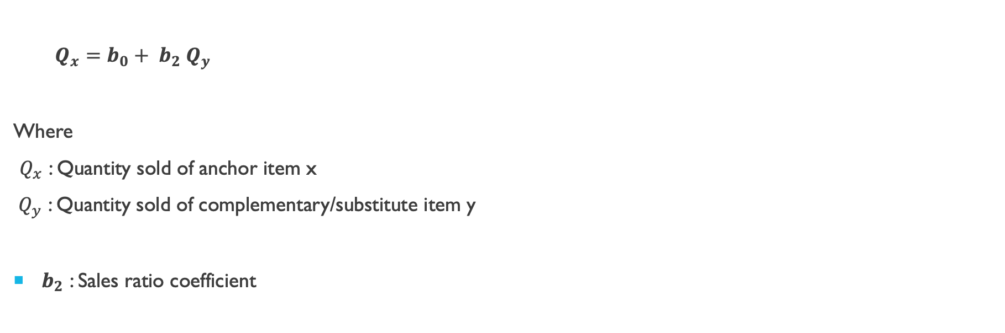
Sales_ratio
$Q_{x}=b_{0}+ b_{2} Q_{y}$
Where
$Q_{x}$ : Quantity sold of anchor item x
${ Q}_{y}$ : Quantity sold of complementary/substitute item y
$b_{2}$ : Sales ratio coefficient

Slide 9
Cross price elasticity
E_{A,B}=. (%ChangeinQuantityDemandedforGoodA) / (%ChangeinPriceofGoodB)
Complementary goods have a negative cross- price elasticity: as the price of one good increases, the demand for the second good decreases.
Substitute goods have a positive cross-price elasticity: as the price of one good increases, the demand for the other good increases.
​

Slide 10
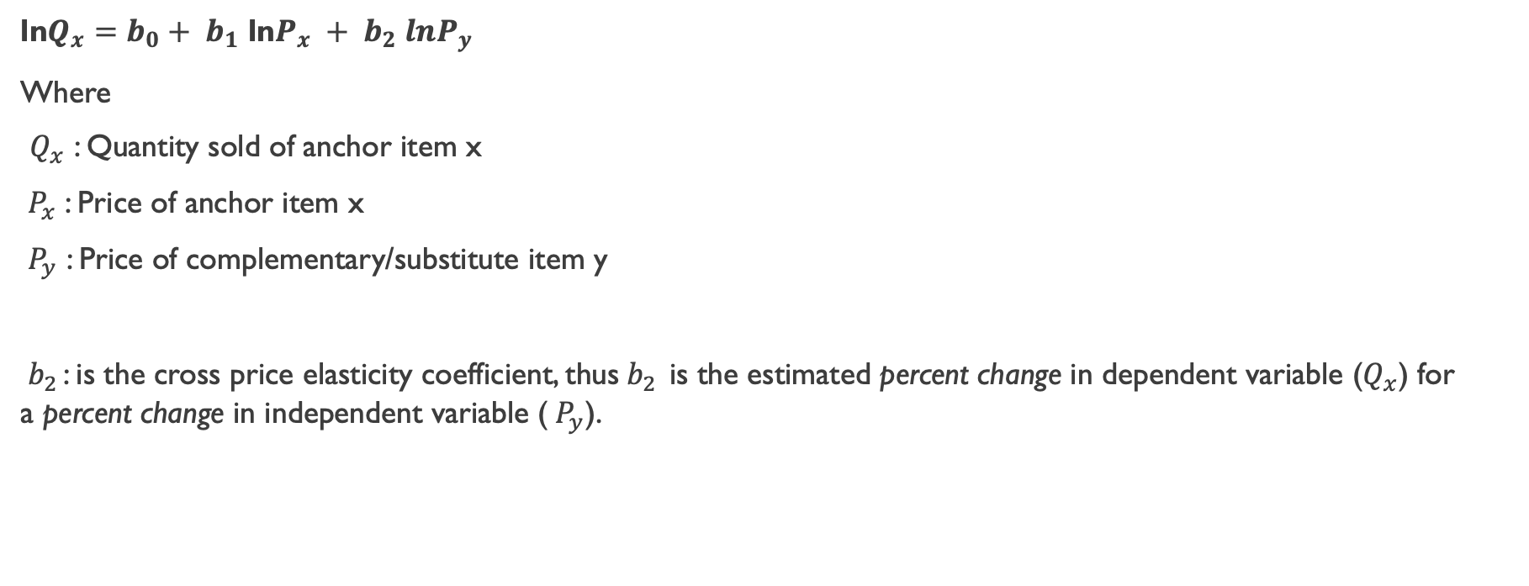
Formula : cross price elasticity
ln$Q_{x}=b_{0}+ b_{1}$ ln$P_{x} + b_{2} lnP_{y}$
Where
$Q_{x}$ : Quantity sold of anchor item x
${ P}_{x}$ : Price of anchor item x
${ P}_{y}$ : Price of complementary/substitute item y
${ b}_{2 }$: is the cross price elasticity coefficient, thus${ b}_{2 }$is the estimated percent change in dependent variable ($Q_{x}$) for a percent change in independent variable (${ P}_{y}$).

Slide 11
Revenue uplift
Uplift in gross profit due to current promotion
Item1:Anchor item (on promotion) substitute items of anchor_item: a, b complementary item of achor_item: y
b and y are non promoted products
Revenue= Qty sold * promotion_price
Revenue_adj = Revenue
- similarity_index(item1,b) * (uplift of b) * b_price
+ affinity_index(item1,y) * (uplift of y) * y_price
Revenue_uplift= Revenue– baseline*non_promo_price/baseline *non_promo_price
Revenue_Uplift_Adj = Revenue_adj – adjusted_baseline * non_promo_price /adjusted_baseline * non_promo_price

Slide 12
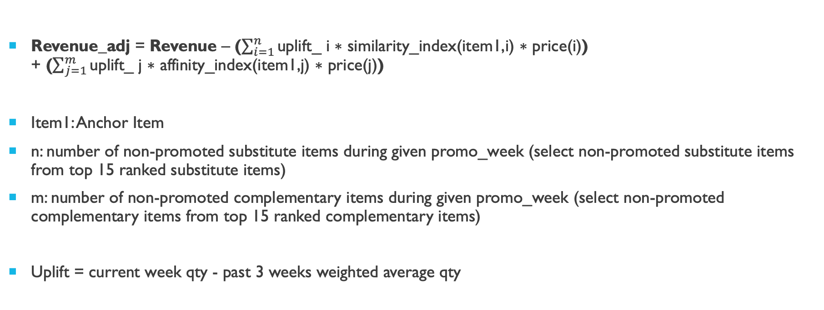
Adjusted Revenue Formula
Revenue_adj = Revenue – ($\sum_{i=1}^{n}{\text{uplift}\text{_} \text{i} \text{∗ }\text{similarity}\text{_}\text{index}\text{(}\text{item}\text{1,}\text{i}\text{) ∗ }\text{price}\text{(}\text{i}\text{)}\text{)} }$ + ($\sum_{j=1}^{m}{\text{uplift}\text{_} \text{j} \text{∗ }\text{affinity}\text{_}\text{index}\text{(}\text{item}\text{1,}\text{j}\text{) ∗ }\text{price}\text{(}\text{j}\text{)}}$)
Item1: Anchor Item
n: number of non-promoted substitute items during given promo_week (select non-promoted substitute items from top 15 ranked substitute items)
m: number of non-promoted complementary items during given promo_week (select non-promoted complementary items from top 15 ranked complementary items)
Uplift = current week qty - past 3 weeks weighted average qty

Slide 13
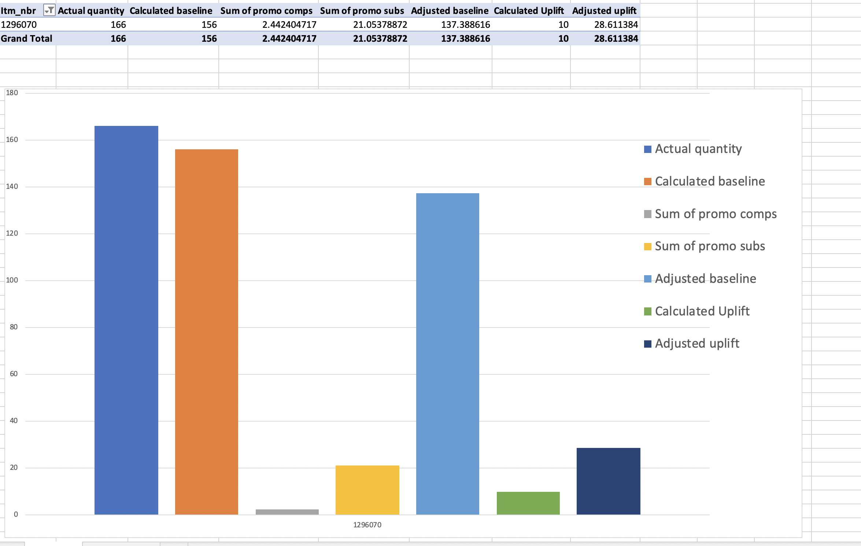
Adjusted baseline

Slide 14
Assumptions
1) While calculating adj_baseline, nullifying the impact of sub/comp in promotion showing negative uplift
2) While calculating revenue nullify the impact of complementary items showing negative uplift and substitute showing positive uplift (comp/sub non-promoted)
3) Currently considering tpr promotions only
4) Not considering multiple weeks promotion both for anchor item and comp/sub items

Slide 15
Impact
Determine which promotions are effective, which ones are not, and why.
Eliminate or modify ineffective promotions.
Reinvest the savings in more competitive prices and better merchandising.

Slide 16
Future steps
Calculate baseline for comp/sub items using an API
Calculate cross price elasticity using API
Generate a list of items to which given item is complementary
Use other promotions like bogo,nlp etc.
Add Pull Forward impact
Take last 3 non-promo weeks avg of sub/comp as baseline
Even if only com/only sub items available for any base item, compute adj baseline and revenue for the same

Slide 17
FLAGS and checks
Adjusted Baseline
If adj_baseline < qty_reg => true_adj_baseline = baseline_sse : lower_bound_check
If adj_baseline > qty => true_adj_baseline = baseline_sse : upper_bound_check
If adj_baseline < 0 => true_adj_baseline = baseline_sse : lower_bound_check
Adjusted Revenue
If baseline_sse = qty => true_adj_revenue = revenue : baseline equals to qty
If adj_revenue < 0 => true_adj_revenue = revenue/0 : negative revenue check
If percentage difference of revenue and adj_revenue is 2 standard deviation more than revenue => true_adj_revenue = revenue : outlier

Slide 18
Validation (adjusted baseline)
OBJECTIVE : As adjusted baseline is completely dependent on baseline_sse, objective of validation is to check the direction of adjusted_baseline with respect to actual quantity
- data selection:
1) use baseline calculation during non-promo weeks to calculate adjusted_baseline
2) remove data points where actual quantity and baseline_sse are equal
3) remove data points where actual quantity or baseline_sse is equal to 0
4) remove data points where price of item is equal to 0
5) select items having complementary and substitute items available
-Follow the complete procedure for all items on each date to calculate adjusted_baseline
-calculate 'direction' of calcualted adjusted_baseline with respect to actual quantity (MAPE_adj < MALPE_see => direction=1,else=0)
-calculate 'MAPE' of adjusted_baseline
-calculate 'percentage improvement' of adjusted_MAPE over sse_MAPE for all items where direction=1

Slide 19
Validation (adjusted revenue)
calculating percentage of data having flag=‘outlier’

